Slide 1

Happiness is something that people seek to find, yet what defines happiness can vary from one person to the next. It is an emotional state characterized by feelings of joy, satisfaction, contentment, and fulfillment.

Slide 2
Happiness is free! Happiness is one of the contributing factor for development and progress of a country. The level of happiness a citizens of a country feel determines the performance of economic activities and growth of the country. A lot of factors are responsible for the level of happiness one feels. In this presentation, 167 countries has 6 variables (Economy_GDP, Family_SocialSupport, Health_LifeExpectancy, Freedom, Trust_GovtCorruption, Generosity) as their happiness determinants. We will analyze the variables used as benchmark to determine the happiness ranking and score of each countries under review.
PROBLEM STATEMENT
AIMS & OBJECTIVES
To determine the 5 highly ranked countries and discover their strategies for their score.
To discover causes of the low scores and suggest solutions.
To suggest how low ranked countries can boost her happiness score.

Slide 3
OVERVIEW
World Happiness Report of 2015 to 2022
Extraction
with
Microsoft SQL Server
Presented
By
Lilian Nwafor
19th January 2023

Slide 4
Processes
Data Collection: The data was collected from kaggle: https://www.kaggle.com/datasets/mathurinache/world-happiness-report Tools Used: Microsost SQL was used for data extraction and visualization analysis was done in Tableau public Data Exploration: The datasets contained 1229 rows and 11 columns of which 6 variables dependent variables (Economy_GDP, Family_SocialSupport, Health_LifeExpectancy, Freedom, Trust_GovtCorruption. Generosity) There are 167 countries in 13 regions under review. The year under review is 2015 to 2022

Slide 5
Data Extraction
The following shows the metrics used for data extraction. Query 1: countries ranking between 130 and 150 in economy (GDP) i.e ranking the top 20 all year Query 2: countries ranking between 1 and 20 in economy(gdp) i.e ranking the least 20 all year Query 3: countries ranking between 130 and 150 in family_socialsupport i.e ranking the top 20 all year Query 4: countries ranking between 1 and 20 in family_socialsupport i.e ranking the least 20 all year Query 5: countries ranking between 130 and 150 in health_lifeexpectancy i.e ranking the top 20 all year Query 6: countries ranking between 1 and 20 in health_lifeexpectancy i.e ranking the least 20 all year Query 7: countries ranking between 130 and 150 in freedom i.e ranking the top 20 all year Query 8: countries ranking between 1 and 20 in freedom i.e ranking the least 20 all year Query 9: countries ranking between 130 and 150 in trust_govtcorruption i.e ranking the top 20 all year Query 10: countries ranking between 1 and 20 in trust_govt corruption i.e ranking the least 20 all year Query 11: countries ranking between 130 and 150 in generosity i.e ranking the top 20 all year Query 12: countries ranking between 1 and 20 in generosity i.e ranking the least 20 all year Query 13: countries ranking between 130 and 150 i.e ranking the top 20 all year Query 14: countries ranking between 1 and 20 i.e ranking the least 20 all year Query 15: countries with happiness score 7 above all year Query 16: countries with happiness score less thn 1 all year Query 17: top 20 countries rated high on happiness score

Slide 6
Data Extraction Continues
Query 18: countries in western europe region, year with happiness score less than 20 Query 19: countries in western europe region, year with happiness score greater than 70 to to 102 Query 20: countries in middle east and north africa region, year with happiness score less than 50 Query 21: countries in middle east and north africa region, year with happiness score greater than 70 to 102 Query 22: countries in north america and anz region, year with happiness score less than 20 and there no other country that fall above 100 Query 23: countries in sub-saharan africa region, year with happiness score between 50 t0 100 Query 24: countries in middle east and northern africa region, year with happiness score < 50 Query 25: countries in middle east and northern africa region, year with happiness score > 130 Query 26: countries in asia regions, year with happiness score > 130

Slide 7
Analysis and Result of the Data Extracted
Query 1: countries ranking between 130 and 150 in economy (GDP) i.e ranking the top 20 all year There are 47 countries under this category. Among the countries that are under this categories, Bulgaria and Garbon have score of GDP of 1.01 and 1.06 respectively while other Countries has below 1.0 in 2015. Malawi had the minimum value of 0.02 of GDP in 2015. Guinea ranked the least of 150 In 2016, Botswana’s GDP was 1.09 and Garbon 1.16 which recorded the highest value in GDP while the the country with the lowest value is Malawi with 0.09 value. Liberia ranked 150 In 2017 category Botswana recorded the highest GDP of 1.12 while Liberia had 0.12 GDP. Togo ranked 150 2018 Botswana recorded the highest 1.02 while congo (Kinshasa) recorded the lowest of 0.07. Syria ranked 150 In 2019, Botswana and Burundi scored the highest and lowest of 1.04 and 0.05 of GDP repectively. Malawi ranked 150 2020, Botswana had 1.00 and Burundi 0.00 og GDP. Rwanda ranked 150 2021. Botswana 1.10 GdP while the minimum is Burundi with 0.00. Afghanistan ranked 149 2022. Botswana recorded 1,503.00 while Malawi has a record of 648.00. Afghanistan ranked least of 146 of all the countries in GDP

Slide 8
Analysis and Result of the Data Extracted
Query 2: Countries ranking between 1 and 20 in economy(GDP) i.e ranking the least 20 all year This shows the detailed chart of countries ranking from 1 to 20 in the world happiness rank in the years under review with respect to GDP In the year 2015, Switzerland ranked 1 with GDP of 1.39651 while united Arab emirate ranked 20 with GDP of 1.42727 2016 shows that Denmark ranked 1 (1.44178) while Luxembourg ranked 20(1.69752) 2017 Norway ranked 1(1.616463184) while Chile ranked 20 (1.25278461) 2018 Finland ranked 1 (1.305) while Israel ranked 19 (1.301) 2019 Finland ranked 1(1.34) while Czech republic rank2d 20(1.269) 2020 Finland ranked 1(1.285189509) while Belgium ranked 20(1.295842767) 2021 Finland ranked (1.446) while Belgium ranked 20 (1.463) 2022 Finland ranked 1(1,892) while France ranked 20(1,863)

Slide 9
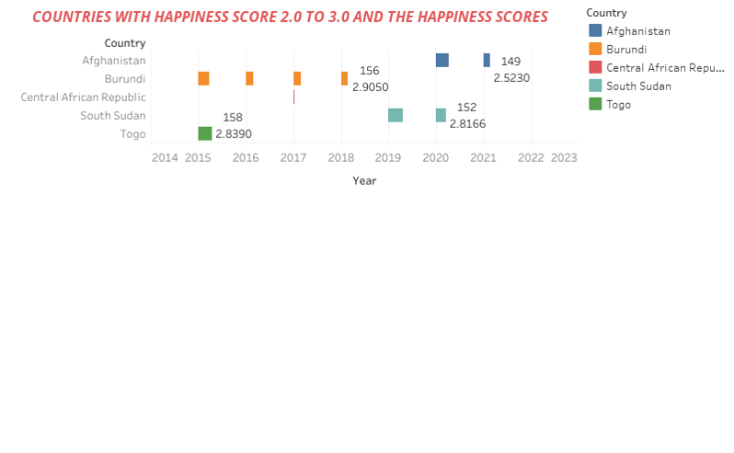
Analysis and Result of the Data Extracted
Query 16: countries with happiness score between 2.0 to 3.0 This shows the countries in this category (Afghanistan, Burundi, Togo, South Sudan and Central African Republic) in2015, Togo scored 158 and Burundi scored 157. 2016, only Burundi fells in this categories with score of 157 In 2017 also Burundi scored 154. 2018 also recorded 156 for Burundi In 2020, Afghanistan and south Sudan fell in this category with 153 and 152 respectively. 2021 has only Afghanistan scoring 149 in the category.

Slide 10
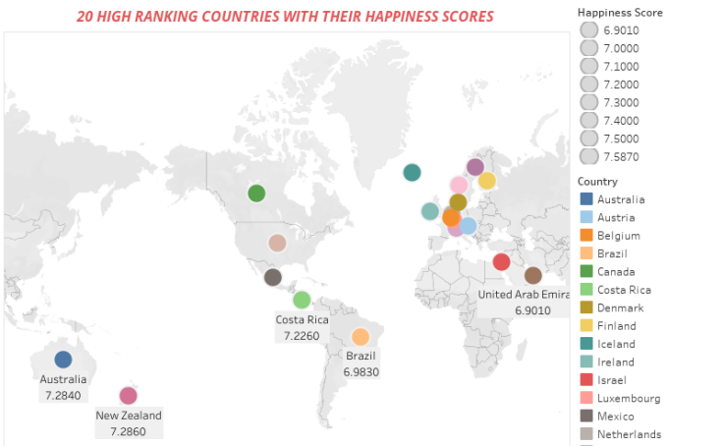
Analysis and Result of the Data Extracted
Query 17: Top 20 countries rated high on happiness score This shows the top 20 countries ranking between 6.0 to 8.0. switserland scoed the highest of 7.5870 while United Arab had the lowest score of 6.9010

Slide 11
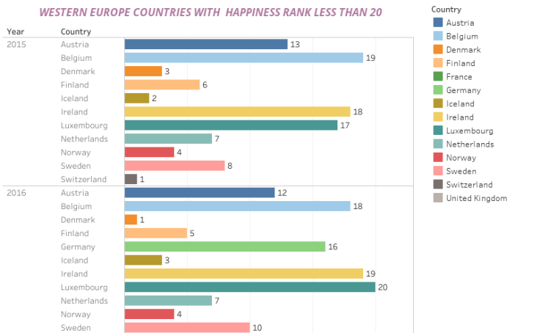
Analysis and Result of the Data Extracted
Query 18: Countries in western Europe region, year with happiness rank less than 20 About 14 countries fall in this category. In 2015, Switzerland took the 1st position while Belgium took the 19th position. 2016, Denmark was 1st while Luxembourg was 20th. In 2017, Norway took 1st while United Kingdom took 19th position. The result of 2018 shows that 1st position was for Finland and the lowest Luxembourg with 17 score. 2019 recorded Finland 1st position and the 1st Belgium with the 18th position, in 2020, 2021 and 2022, Finland took the 1st position leaving the 20th position for Belgium in 2020 and 2021 while France took the 20th position in 2022.

Slide 12
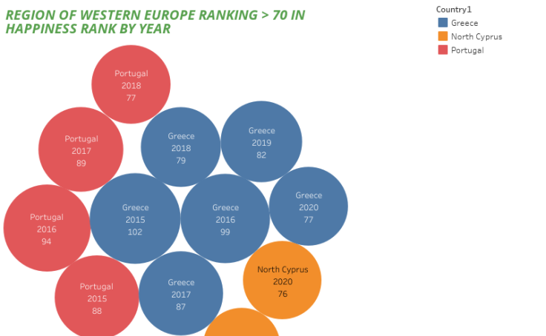
Analysis and Result of the Data Extracted
Query 19: Countries in western Europe region, year with happiness rank greater than 70 to 102 In this category, 3 countries of Greece, Portugal and north Cyprus are under review. The result show that Greece is the worse ranked country with rank or 102, 99, 87, 79, 82, 77 in 2015-2020 respectively.

Slide 13
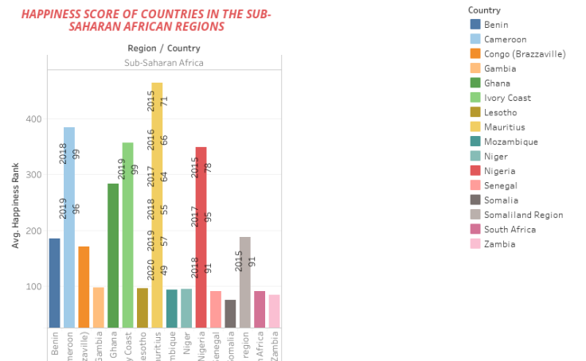
Analysis and Result of the Data Extracted
Query 23: Countries in sub-saharan africa region, year with happiness rank between 50 t0 100 16 countries are found in this category,

Slide 14
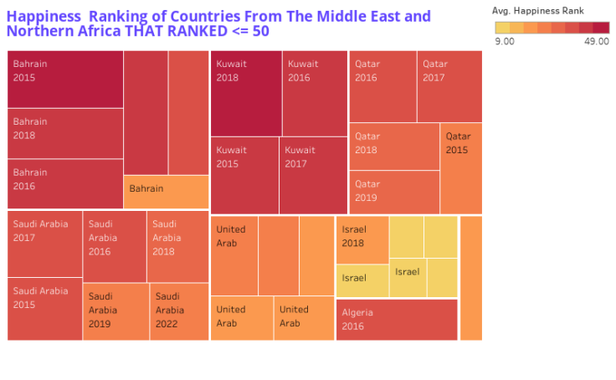
Analysis and Result of the Data Extracted
Query 24: countries in middle east and northern africa region, year with happiness score < 50 This query shows happiness scores of countries in From The Middle East and Northern Africa for the years under review . Israel ranked better than all other countries in these regions with the happiness score of 11, 11, 11, 19, 13 and 9 in 2015, 2016, 2017, 2018, 2019 and 2022 respectively While Bahrain rated lowest among the other countries.

Slide 15
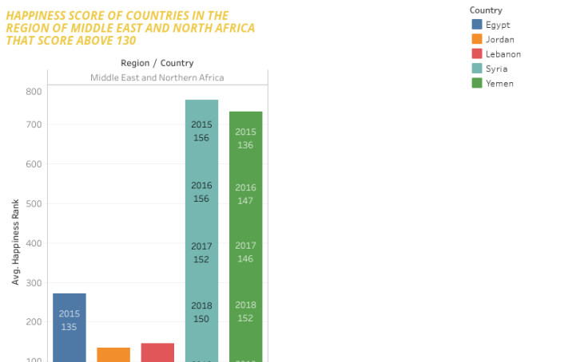
Analysis and Result of the Data Extracted
Query 25: Countries in middle east and northern Africa region, year with happiness score > 130 There are 5 countries in this category, Syria is ranked the worst in all the years under review

Slide 16
Challenges
I had a little itch with importing data and changing the data types as should be in Microsoft SQL server and exporting data.
conclusion
From the records of happiness ranks and happiness scores, it is obvious that the countries that scored well have benchmark they have met that is moving all aspect of their economy. The poorly ranked countries still have a long way to go.
suggestion
Proper research should be done by the poorly ranked countries to atleast solve the basic need of her citizens. Freedom, health and family support are important for the existence of every citizen.
BECAUSE HAPPINESS SHOULD BE FREE

